Slide 1
Exploring venues in Bangalore,India

Slide 2
Introduction
Background
Bangalore also known as the “The Silicon Valley Of India” is a hotspot of all the HQ of tech Giants in India.Due to this reason there are a lot of freelancers who visit the city frequently.With this project I am trying to come up with a solution for these people to explore the venues present nearby.
Problem
Data that might contribute to exploring the different venues in bangalore,with the help of data science we will come with a solution to predict the most visited venues in a cluster.
Interest
All the freelancers who are visiting the city can explore these venues..

Slide 3
Data acquisition and cleaning
Data sources
I have collected the data of area wise postal code of bangalore though a India TV website and downloaded a csv file from the internet having latitudes and longitudes of all the postal codes of india .
Finally I have used Foursquare API for collecting all the nearby venues data.

Slide 4
Data cleaning
Data downloaded or scraped from multiple sources were combined into one table. There were a lot of missing values, because of lack of record keeping.There are several problems with the First datasets.It contained all the postal code of the neighborhood of india, I cleaned it out and formed a new table having only required data.After fixing these problems, I checked for outliers in the data. I found there were some extreme outliers, mostly caused by some types of small sample size problem and then finally created a table by merging the two data sets .

Slide 5
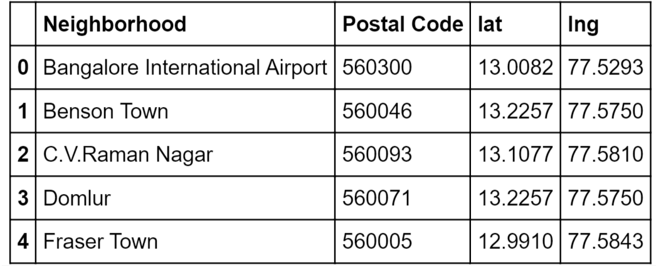

Slide 6
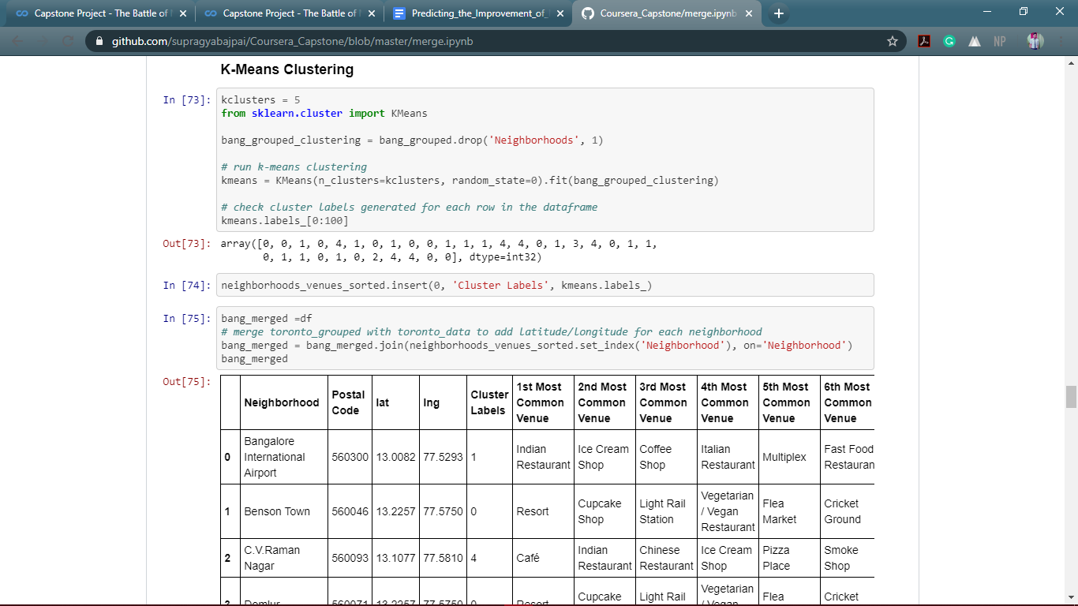
Feature selection
I had to drop multiple columns from the dataset like state and Div from the dataset to make it more efficient in Data Analysis,
Algorithm
I have used K_means algorithm which is one the best clustering algorithm which clusters different data
points which are near to the centroid.

Slide 7
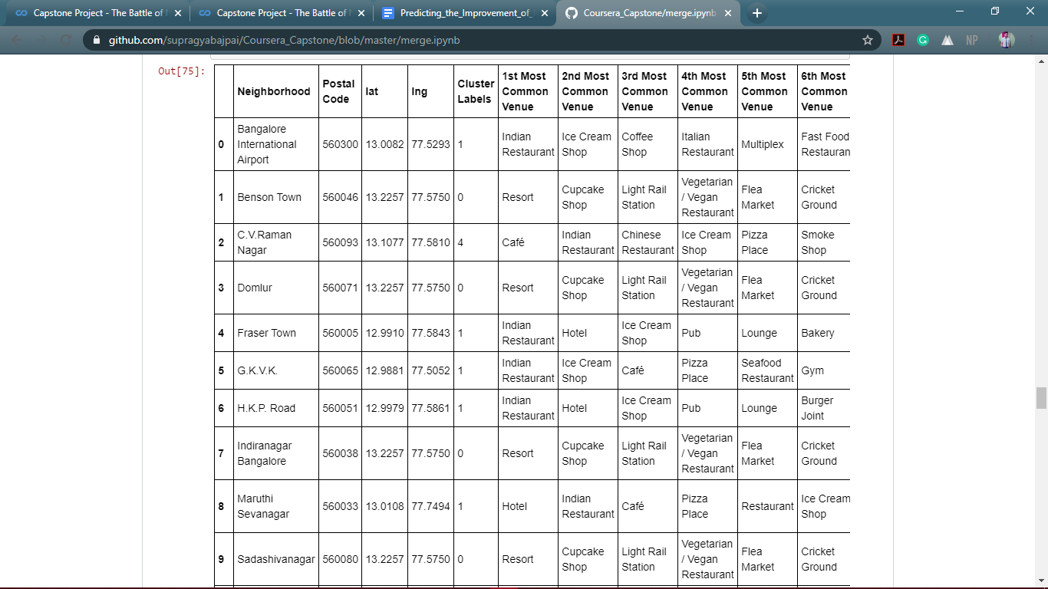
Conclusions
In this study, I analyzed the most common venues of a particular area so that our explorer can visit them if he is willing to.

